Slide 1
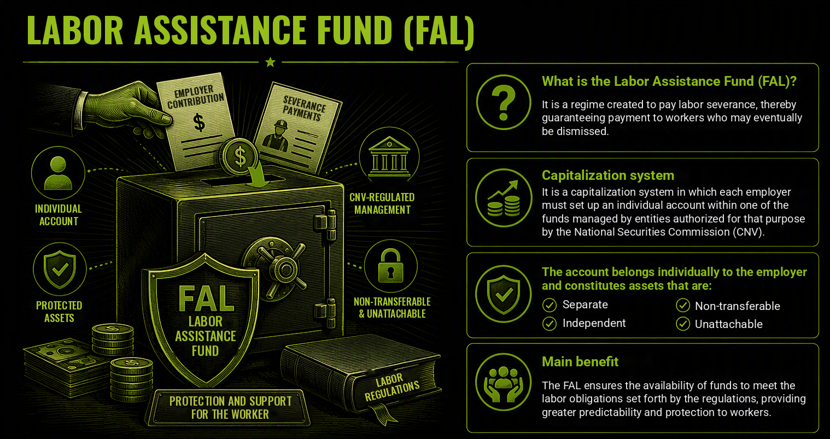

Slide 2
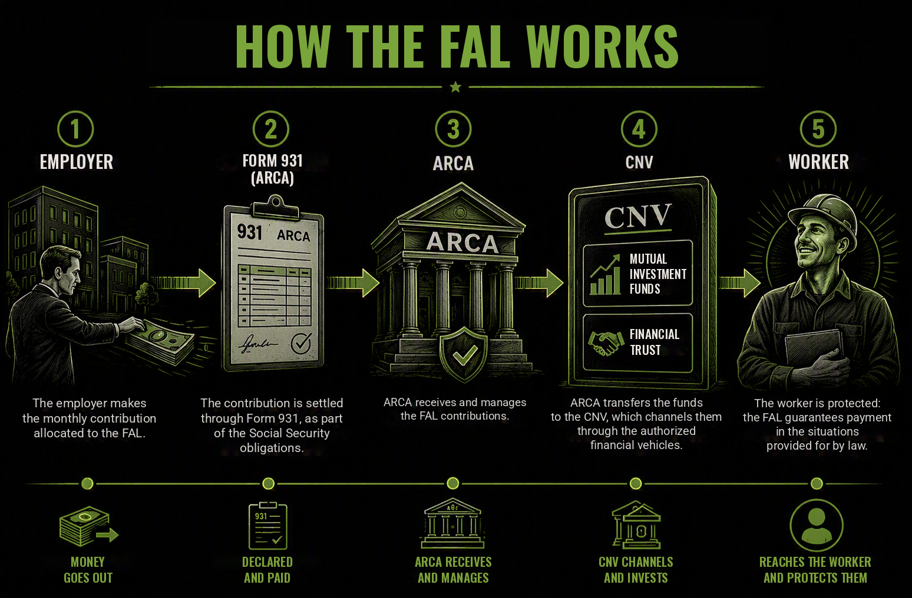

Slide 3
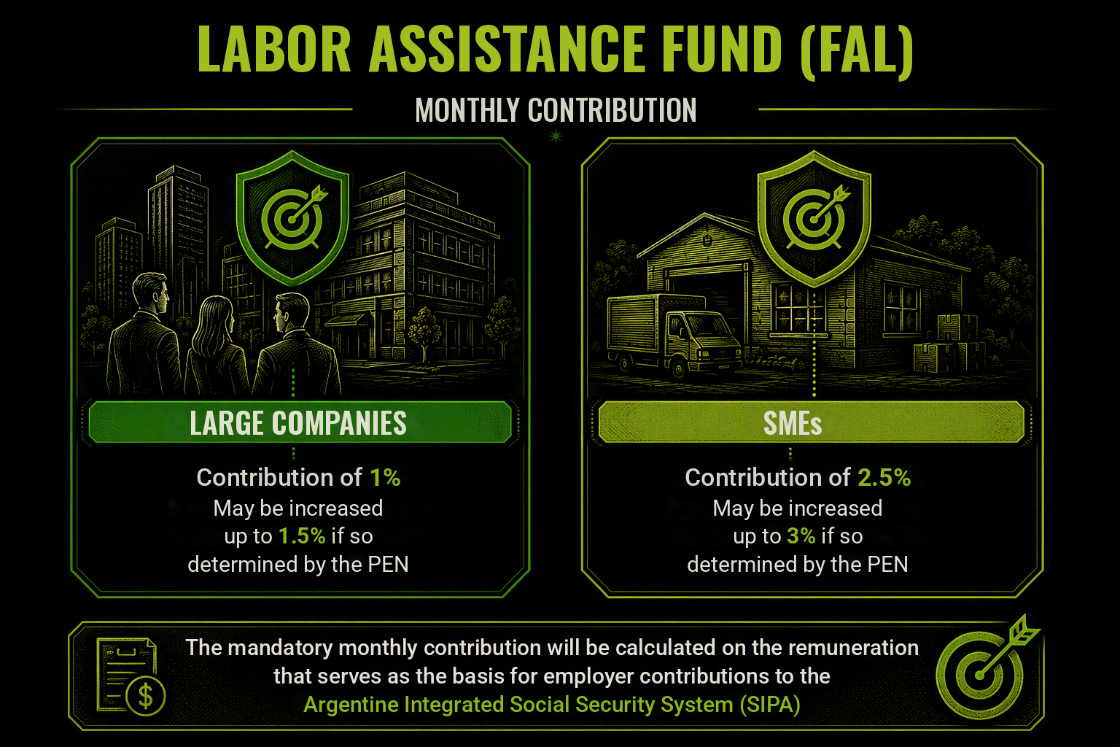

Slide 4
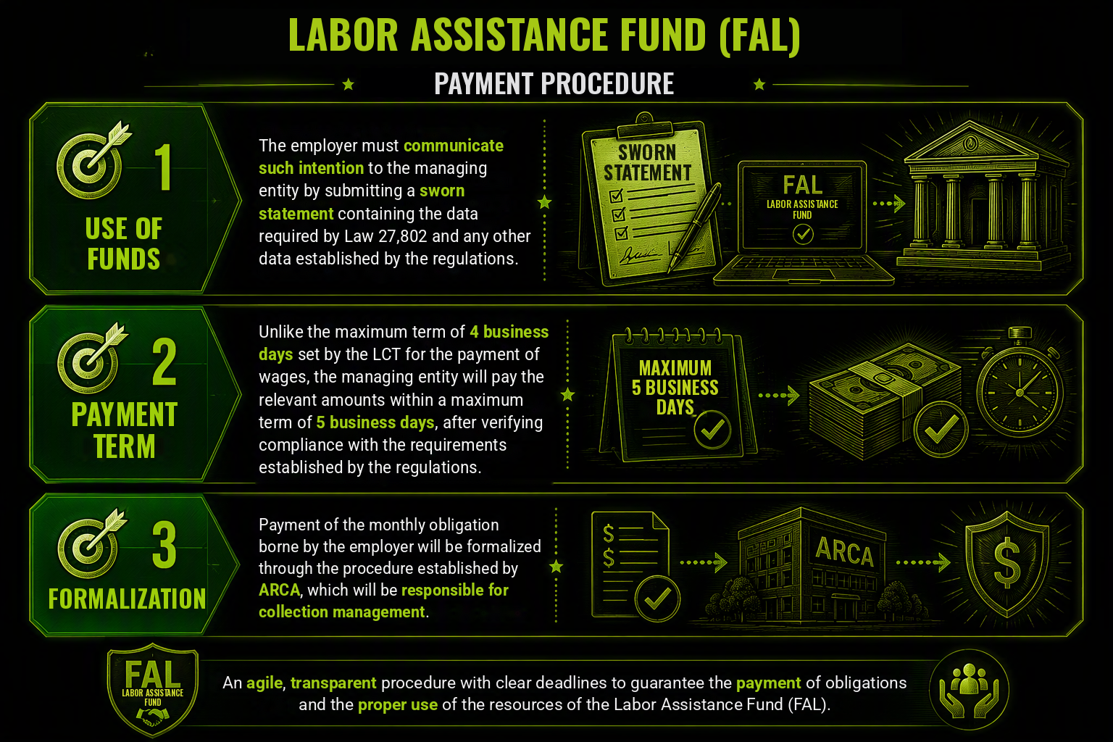

Slide 5
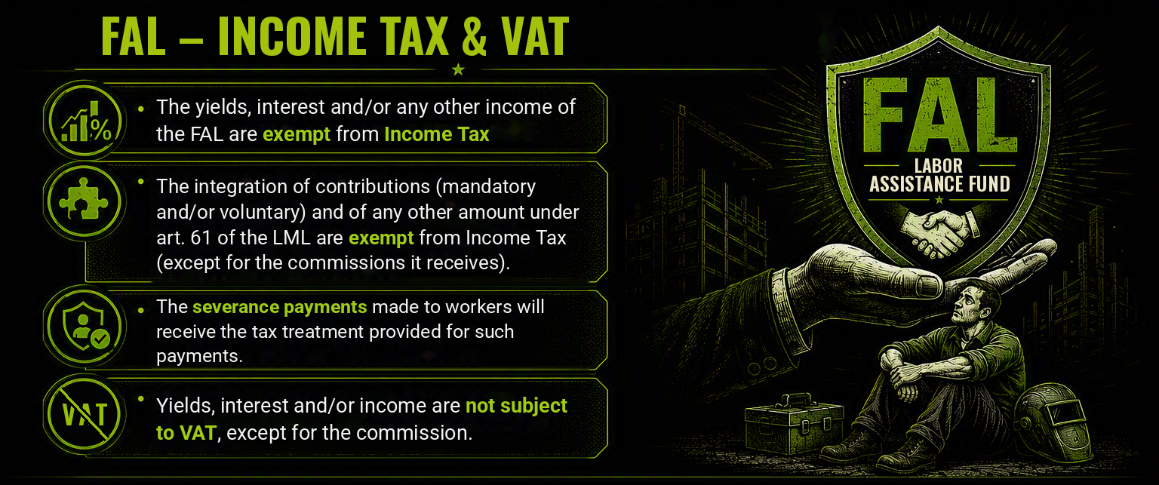

Slide 6

FAL – Investment Policies
Authorized Entities must invest in financial instruments or marketable securities issued and traded in Argentina
Investment in foreign financial instruments is not allowed
Commission capped at 1%

